Slide 1
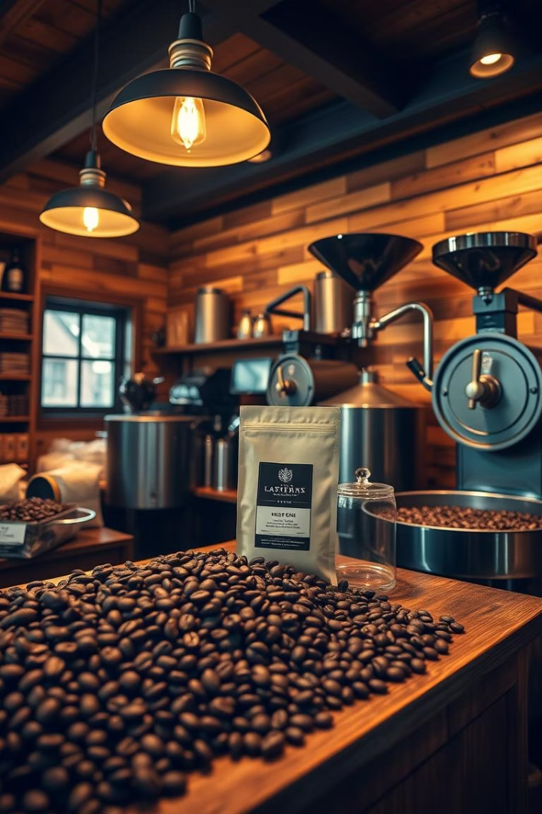
Artisanal Coffee Roastery Management System
Explore how a smart system enhances artisanal coffee roasting efficiency.

Slide 2

Introduction
Market Growth
Global Value
The artisanal coffee market is growing rapidly worldwide.
Projected to reach $83.5 billion by 2025.
Focus Areas
Quality, sustainability, and unique flavor profiles define success.

Slide 3

Problem Definition
Manual Process Issues
Inefficient, error-prone operations in many roasteries.
Data Visibility
No real-time inventory or production tracking.
Traceability Challenges
Difficulty tracking bean origin, roast profiles, preferences.
Scalability Limits
Heavy reliance on spreadsheets and paper restricts growth.

Slide 4
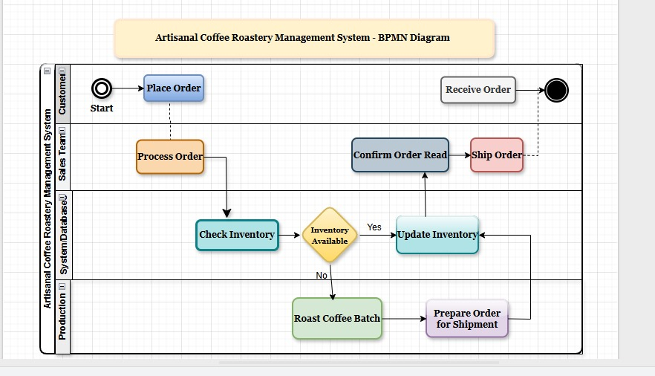
Methodology & Approach:System
Architecture
Database Design
Entities Modeled
Data Relationships
Reliable PostgreSQL database organizes roastery data efficiently.
Product
Customer places Orders; Orders include Products for seamless tracking.
Customer
Orders
Suppliers
Coffee Inventory
Roastery

Slide 5
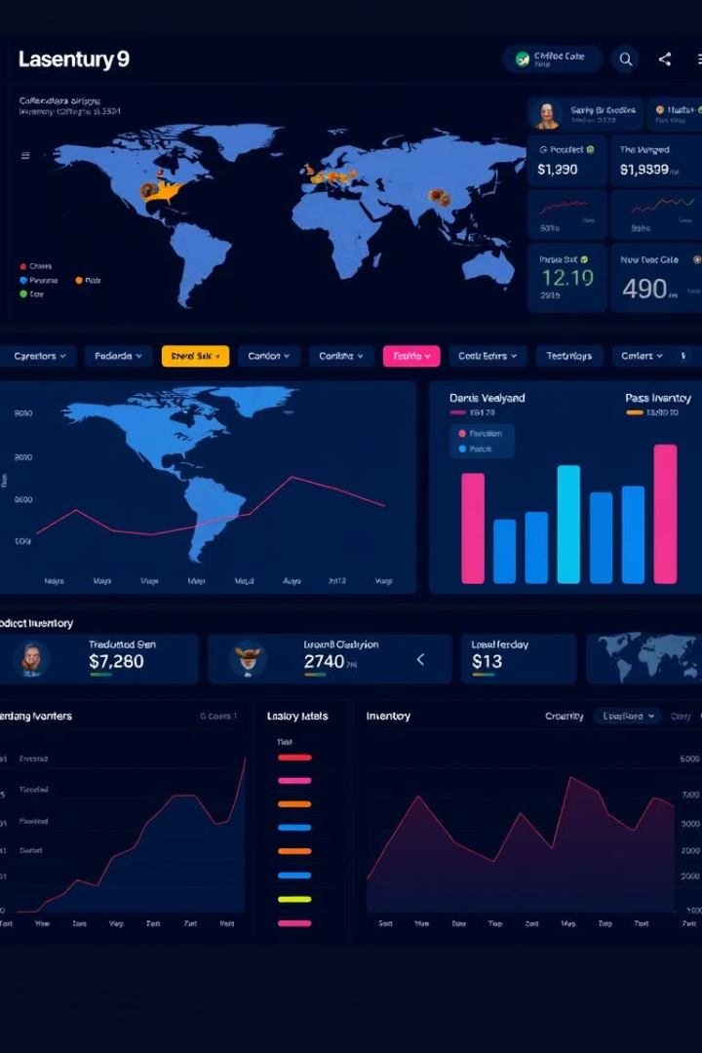




Methodology & Approach: Key Modules
Inventory Management
Roastery Operations
Customer Management
Real-time tracking of green coffee beans to reduce waste.
Scheduling, roast profile control, and quality assurance.
Tracks preferences, orders, and valuable feedback.
Reporting & Analytics
Sales trends, inventory turnover, and supplier insights.

Slide 6
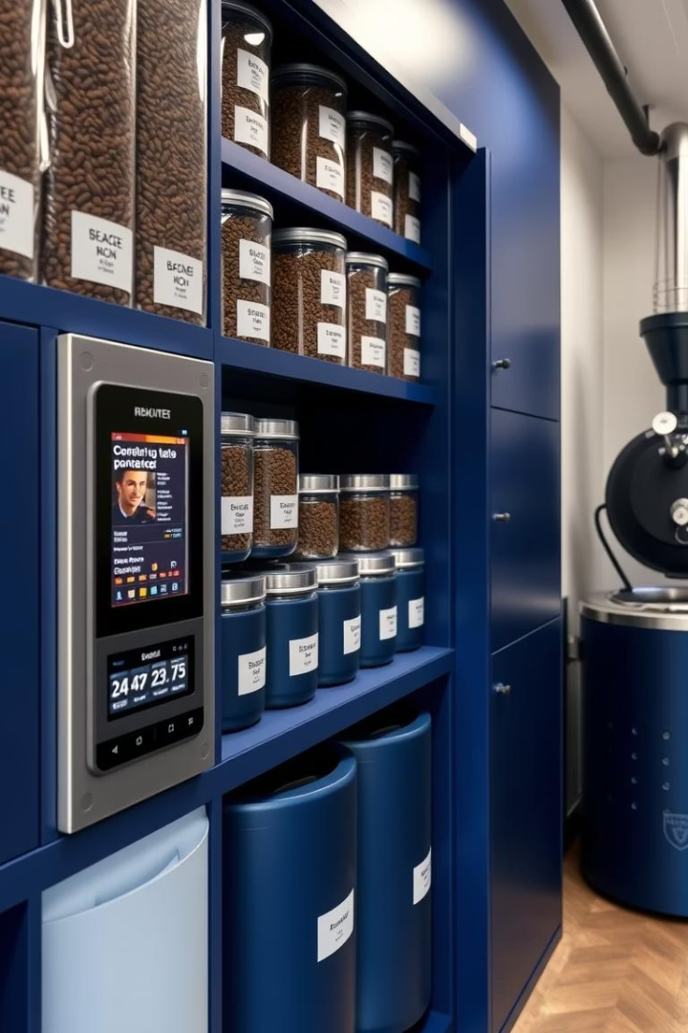
Results: Inventory Management
Inventory Accuracy
Improved accuracy by 95%, minimizing shortages.
Stockout Reduction
Reduced stockouts by 40%, enhancing customer service.
Demand Forecasting
Optimized reorder points to match demand.
Waste Reduction
Decreased waste by 15%, saving costs.

Slide 7
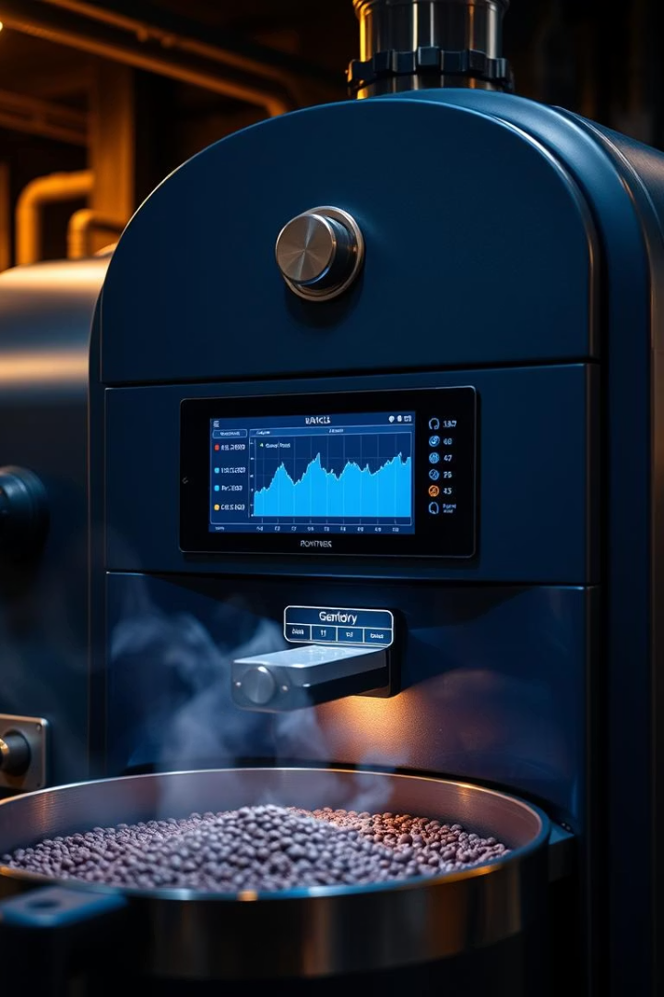
Results: Roastery Operations
1
Roast Quality
Consistent quality via optimized roast profiles.
2
Production Scale
Capacity increased by 20% to meet demand.
3
Defect Reduction
Roast defects cut by 30% through data-driven adjustments.
4
Energy Efficiency
Energy use per batch reduced by 10%.

Slide 8
Results: Customer Relationship Management
Customer Retention
Marketing Personalization
Order Accuracy
Order Value
Errors reduced by 50%, increasing satisfaction.
Average order size lifted by 15%.
Retention rose by 25% through targeted engagement.
Tailored campaigns based on customer preferences.

Slide 9

Conclusion
Efficiency Gains
Significant operational improvements drive better margins.
Data-Driven Decisions
Real-time insights support smarter management.
Customer Satisfaction
Enhanced experience fuels loyalty and profitability.
ROI
Investment returned within 12 months of use.

Slide 10
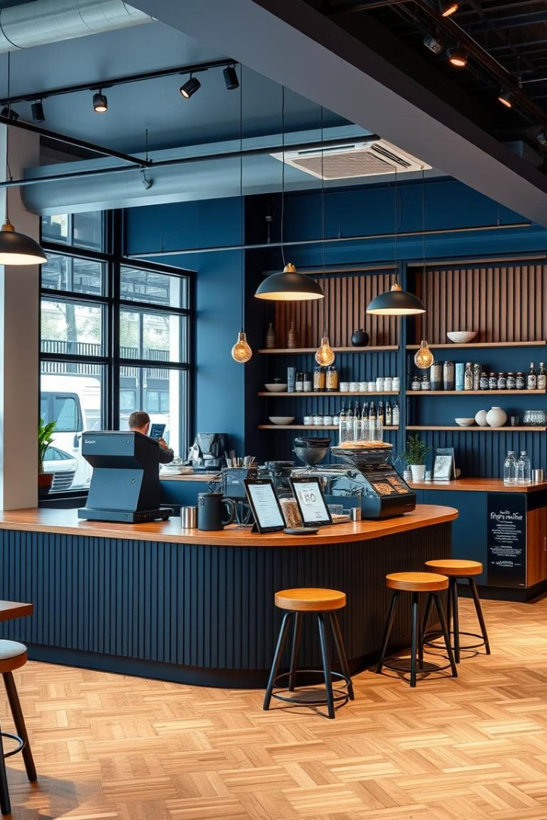




Recommendations and Future Work
E-Commerce Integration
Enable online sales to expand market reach.
Predictive Analytics
Forecast demand and optimize inventory dynamically.
Mobile App
Facilitate real-time monitoring and management remotely.
Blockchain Tracking
Improve traceability and transparency across supply chain.

